Slide 1
Get Ready…
We’re going to NAME our MULTIPLICATION facts!

Slide 2
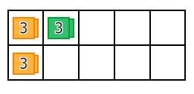
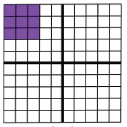
3 x 3 = 9

Slide 3
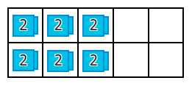
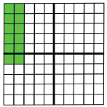
6 x 2 = 12

Slide 4
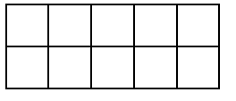
0 x 11 = 0

Slide 5
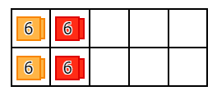
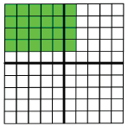
4 x 6 = 24

Slide 6
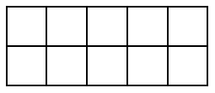
0 x 7 = 0

Slide 7
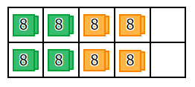
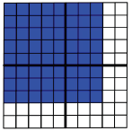
8 x 8 = 64

Slide 8
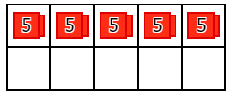
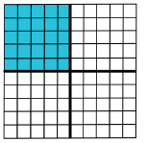
5 x 5 = 25

Slide 9
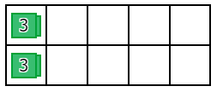
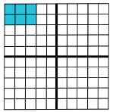
2 x 3 = 6

Slide 10
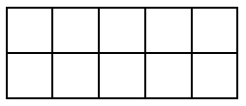
0 x 5 = 0

Slide 11
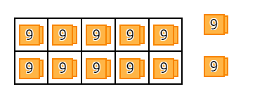
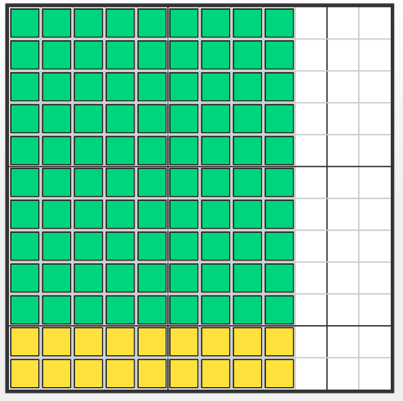
12 x 9 = 108

Slide 12
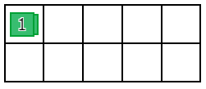
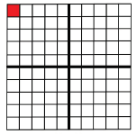
1 x 1 = 1

Slide 13
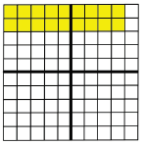
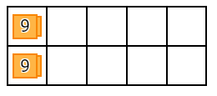
2 x 9 =18

Slide 14
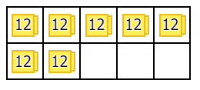
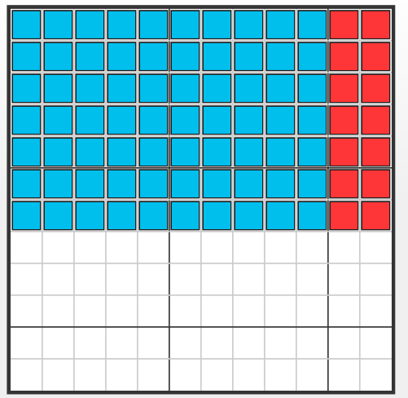
7 x 12 = 84

Slide 15
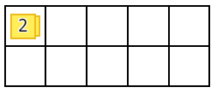
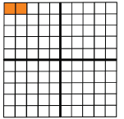
1 x 2 = 2

Slide 16
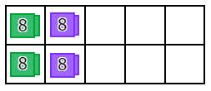
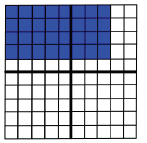
4 x 8 = 32

Slide 17
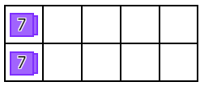
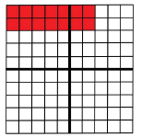
2 x 7 = 14

Slide 18
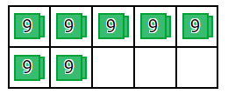
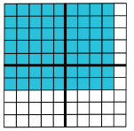
7 x 9 = 63

Slide 19
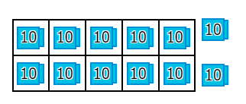
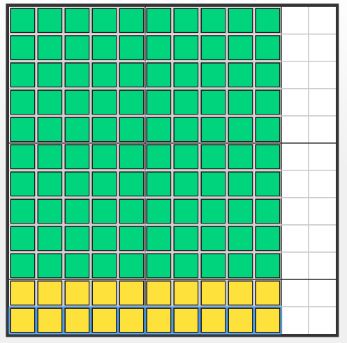
12 x 10 = 120

Slide 20
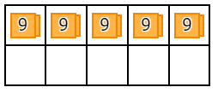
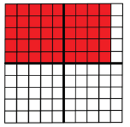
5 x 9 = 45

Slide 21
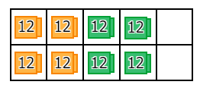
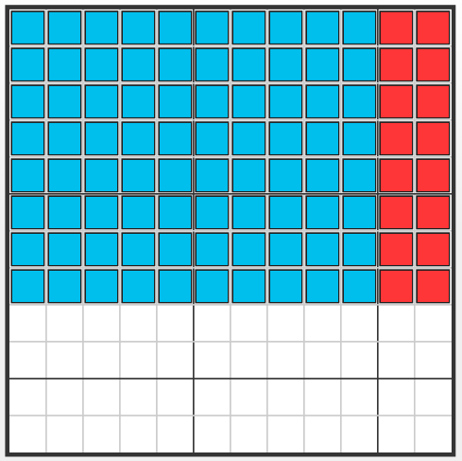
8 x 12 = 96

Slide 22
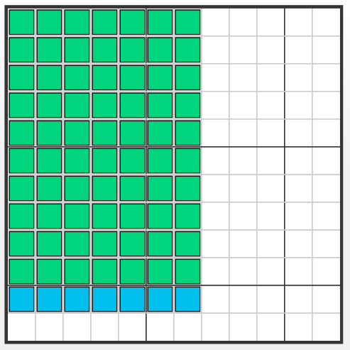
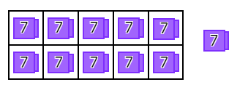
11 x 7 = 77

Slide 23
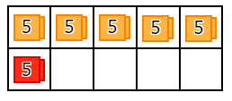
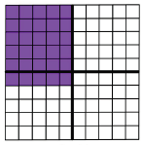
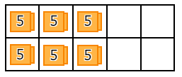
6 x 5 = 30
OR

Slide 24
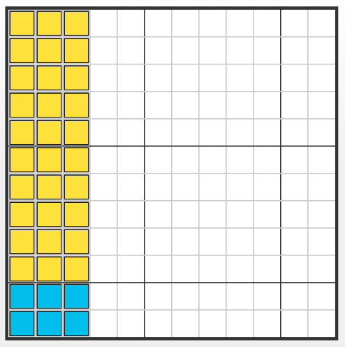
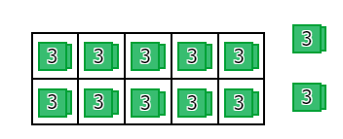
12 x 3 = 36

Slide 25
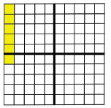
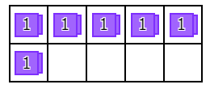
6 x 1 = 6

Slide 26
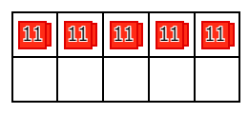
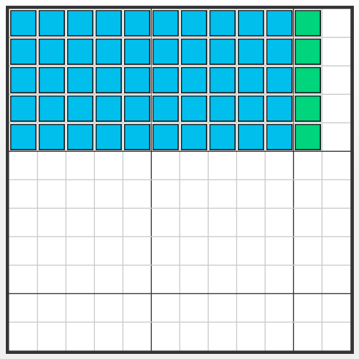
5 x 11 = 55

Slide 27
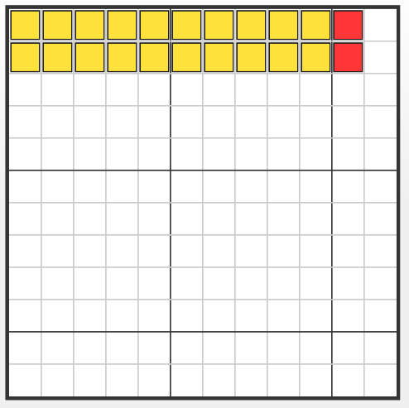
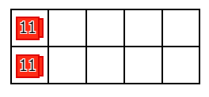
2 x 11 = 22

Slide 28


1 x 10 = 10

Slide 29

4 x 0 = 0

Slide 30


10 x 10 = 100

Slide 31


8 x 2 = 16

Slide 32


3 x 6 = 18

Slide 33


5 x 2 = 10

Slide 34


1 x 4 = 4

Slide 35


6 x 7 = 42

Slide 36

0 x 2 = 0

Slide 37


8 x 5 = 40

Slide 38

0 x 3 = 0

Slide 39


12 x 4 = 48

Slide 40


1 x 5 = 5

Slide 41


7 x 7 = 49

Slide 42


3 x 9 = 27

Slide 43

0 x 1 = 0

Slide 44


2 x 12 = 24

Slide 45


3 x 5 = 15

Slide 46


6 x 12 = 72

Slide 47

0 x 12 = 0

Slide 48


12 x 12 = 144

Slide 49


7 x 8 = 56

Slide 50


3 x 8 = 24

Slide 51


10 x 8 = 80

Slide 52
0 x 6 = 0

Slide 53


1 x 12 = 12

Slide 54


11 x 9 = 99

Slide 55


2 x 10 = 20

Slide 56


9 x 1 = 9

Slide 57


11 x 8 = 88

Slide 58


2 x 2 = 4

Slide 59


8 x 1 = 8

Slide 60


4 x 9 = 36

Slide 61


6 x 8 = 48

Slide 62


10 x 9 = 90

Slide 63


6 x 6 = 36

Slide 64


5 x 10 = 50

Slide 65


9 x 9 = 81

Slide 66


3 x 1 = 3

Slide 67


4 x 7 = 28

Slide 68


7 x 10 = 70

Slide 69


4 x 5 = 20

Slide 70


11 x 4 = 44

Slide 71


7 x 5 = 35

Slide 72

0 x 10 = 0

Slide 73


8 x 9 = 72

Slide 74


6 x 11 = 66

Slide 75
8 x 0 = 0

Slide 76


10 x 11 = 110

Slide 77


4 x 4 = 16

Slide 78


11 x 1 = 11

Slide 79


10 x 6 = 60

Slide 80


4 x 3 = 12

Slide 81
0 x 0 = 0

Slide 82


11 x 12 = 132

Slide 83


3 x 11 = 33

Slide 84


12 x 5 = 60

Slide 85


2 x 4 = 8

Slide 86


4 x 10 = 40

Slide 87


11 x 11 = 121

Slide 88


3 x 10 = 30

Slide 89


6 x 9 = 54

Slide 90


7 x 1 = 7

Slide 91
0 x 9 = 0

Slide 92


3 x 7 = 21

Slide 93
Get Ready…
We’re going to NAME our DIVISION facts!

Slide 94


80 ÷ 10 = 8
80
10 x ? = 80

Slide 95


28 ÷ 7 = 4
28
7 x ? = 28

Slide 96


5 ÷ 1 = 5
5
1 x ? = 5

Slide 97


35 ÷ 7 = 5
35
7 x ? = 35

Slide 98


0 ÷ 12 = 0
0
12 x ? = 0

Slide 99


7 ÷ 7 = 1
7
7 x ? = 7

Slide 100


72 ÷ 9 = 8
72
9 x ? = 72

Slide 101


56 ÷ 8 = 7
56
8 x ? = 56

Slide 102


22 ÷ 1 1 = 2
22
11 x ? = 22

Slide 103


10 ÷ 1 = 10
10
1 x ? = 10

Slide 104


9 ÷ 9 = 1
9
9 x ? = 9

Slide 105


42 ÷ 6 = 7
42
6 x ? = 42

Slide 106


3 ÷ 3 = 1
3
3 x ? = 3

Slide 107


77 ÷ 1 1 = 7
77
11 x ? = 77

Slide 108

63 ÷ 9 = 7
63
9 x ? = 63

Slide 109

49 ÷ 7 = 7
49
7 x ? = 49

Slide 110

12 ÷ 3 = 4
12
3 x ? = 12

Slide 111

132 ÷ 1 1 = 12
132
11 x ? = 132

Slide 112

33 ÷ 3 = 11
33
3 x ? = 33

Slide 113


12 ÷ 6 = 2
12
6 x ? = 12

Slide 114

84 ÷ 7 = 12
84
7 x ? = 84

Slide 115

0 ÷ 1 1 = 0
0
11 x ? = 0

Slide 116


0 ÷ 10 = 0
0
10 x ? = 0

Slide 117

36 ÷ 6 = 6
36
6 x ? = 36

Slide 118

32 ÷ 8 = 4
32
8 x ? = 32

Slide 119


14 ÷ 2 = 7
14
2 x ? = 14

Slide 120

3 ÷ 1 = 3
3
1 x ? = 3

Slide 121

27 ÷ 3 = 9
27
3 x ? = 27

Slide 122

24 ÷ 2 = 12
24
2 x ? = 24

Slide 123


108 ÷ 12 = 9
108
12 x ? = 108

Slide 124


16 ÷ 4 = 4
16
4 x ? = 16

Slide 125

0 ÷ 9 = 0
0
9 x ? = 0

Slide 126

22 ÷ 2 = 11
22
2 x ? = 22

Slide 127


35 ÷ 5 = 7
35
5 x ? = 35

Slide 128

27 ÷ 9 = 3
27
9 x ? = 27

Slide 129

110 ÷ 11 = 10
110
11 x ? = 110

Slide 130

24 ÷ 8 = 3
24
8 x ? = 24

Slide 131

48 ÷ 12 = 4
48
12 x ? = 48

Slide 132

77 ÷ 1 1 = 7
77
11 x ? = 77

Slide 133

36 ÷ 4 = 9
36
4 x ? = 36

Slide 134

24 ÷ 3 = 8
24
3 x ? = 24

Slide 135

9 ÷ 3 = 3
9
3 x ? = 9

Slide 136

30 ÷ 5 = 6
30
5 x ? = 30

Slide 137

20 ÷ 10 = 2
20
10 x ? = 20

Slide 138

0 ÷ 8 = 0
0
8 x ? = 0

Slide 139

8 ÷ 4 = 2
8
4 x ? = 8

Slide 140

55 ÷ 5 = 11
55
5 x ? = 55

Slide 141

36 ÷ 3 = 12
36
3 x ? = 36

Slide 142

18 ÷ 2 = 9
18
2 x ? = 18

Slide 143

36 ÷ 12 = 3
36
12 x ? = 36

Slide 144

33 ÷ 1 1 = 3
33
11 x ? = 33

Slide 145

45 ÷ 9 = 5
45
9 x ? = 45

Slide 146

12 ÷ 12 = 1
12
12 x ? = 12

Slide 147

0 ÷ 7 = 0
0
7 x ? = 0

Slide 148

12 ÷ 4 = 3
12
4 x ? = 12

Slide 149

90 ÷ 10 = 9
90
10 x ? = 90

Slide 150

60 ÷ 12 = 5
60
12 x ? = 60

Slide 151

4 ÷ 2 = 2
4
2 x ? = 4

Slide 152

40 ÷ 10 = 4
40
10 x ? = 40

Slide 153

50 ÷ 10 = 5
50
10 x ? = 50

Slide 154

88 ÷ 1 1 = 8
88
11 x ? = 88

Slide 155

32 ÷ 4 = 8
32
4 x ? = 32

Slide 156

0 ÷ 6 = 0
0
6 x ? = 0

Slide 157

96 ÷ 12 = 8
96
12 x ? = 96

Slide 158

9 ÷ 1 = 9
9
1 x ? = 9

Slide 159

30 ÷ 3 = 10
30
3 x ? = 30

Slide 160

6 ÷ 1 = 6
6
1 x ? = 6

Slide 161

44 ÷ 4 = 11
44
4 x ? = 44

Slide 162

96 ÷ 8 = 12
96
8 x ? = 96

Slide 163

20 ÷ 4 = 5
20
4 x ? = 20

Slide 164

121 ÷ 1 1 = 11
121
11 x ? = 121

Slide 165

0 ÷ 5 = 0
0
5 x ? = 0

Slide 166

40 ÷ 8 = 5
40
8 x ? = 40

Slide 167

1 ÷ 1 = 1
1
1 x ? = 1

Slide 168

108÷ 9 = 12
108
9 x ? = 108

Slide 169

1 1 ÷ 1 1 = 1
11
11 x ? = 11

Slide 170

70 ÷ 10 = 7
70
10 x ? = 70

Slide 171

50 ÷ 5 = 10
50
5 x ? = 50

Slide 172

0 ÷ 4 = 0
0
4 x ? = 0

Slide 173

44 ÷ 1 1 = 4
44
11 x ? = 44

Slide 174

30 ÷ 10 = 3
30
10 x ? = 30

Slide 175

25 ÷ 5 = 5
25
5 x ? = 25

Slide 176

132 ÷ 12 = 11
132
12 x ? = 132

Slide 177

20 ÷ 2 = 10
20
2 x ? = 20

Slide 178

12 ÷ 1 = 12
12
1 x ? = 12

Slide 179

15 ÷ 5 = 3
15
5 x ? = 15

Slide 180

48 ÷ 4 = 12
48
4 x ? = 48

Slide 181

0 ÷ 3 = 0
0
3 x ? = 0

Slide 182

2 ÷ 2 = 1
2
2 x ? = 2

Slide 183

66 ÷ 6 = 11
66
6 x ? = 66

Slide 184

15 ÷ 3 = 5
15
3 x ? = 15

Slide 185

16 ÷ 2 = 8
16
2 x ? = 16

Slide 186

11 ÷ 1 = 11
11
1 x ? = 11

Slide 187

16 ÷ 8 = 2
16
8 x ? = 16

Slide 188

10 ÷ 10 = 1
10
10 x ? = 10

Slide 189

0 ÷ 2 = 0
0
2 x ? = 0

Slide 190

64 ÷ 8 = 8
64
8 x ? = 64

Slide 191

54 ÷ 6 = 9
54
6 x ? = 54

Slide 192

100 ÷ 10 = 10
100
10 x ? = 100

Slide 193

8 ÷ 1 = 8
8
1 x ? = 8

Slide 194

72÷ 6 = 12
72
6 x ? = 72

Slide 195

4 ÷ 1 = 4
4
1 x ? = 4

Slide 196

80 ÷ 8 = 10
80
8 x ? = 80

Slide 197

10 ÷ 5 = 2
10
5 x ? = 10

Slide 198

144 ÷ 12 = 12
144
12 x ? = 144

Slide 199

0 ÷ 1 = 0
0
1 x ? = 0

Slide 200

56 ÷ 7 = 8
56
7 x ? = 56

Slide 201

2 ÷ 1 = 2
2
1 x ? = 2

Slide 202

63 ÷ 7 = 9
63
7 x ? = 63

Slide 203

18 ÷ 6 = 3
18
6 x ? = 18

Slide 204

7 ÷ 1 = 7
7
1 x ? = 7

Slide 205

88 ÷ 1 1 = 8
88
8 x ? = 88

Slide 206

5 ÷ 5 = 1
55
5 x ? = 5

Slide 207

4 ÷ 4 = 1
4
4 x ? = 4

Slide 208

24 ÷ 6 = 4
24
6 x ? = 24

Slide 209

70 ÷ 7 = 10
70
7 x ? = 70

Slide 210

40 ÷ 5 = 8
40
5 x ? = 40

Slide 211

40 ÷ 4 = 10
40
4 x ? = 40

Slide 212

24 ÷ 12 = 2
24
12 x ? = 24

Slide 213

24 ÷ 4 = 6
24
4 x ? = 24

Slide 214

66 ÷ 1 1 = 6
66
11 x ? = 66

Slide 215

8 ÷ 8 = 1
8
8 x ? = 8

Slide 216

21 ÷ 3 = 7
21
3 x ? = 21

Slide 217

8 ÷ 2 = 4
8
2 x ? = 8

Slide 218

18 ÷ 9 = 2
18
9 x ? = 18

Slide 219

84 ÷ 12 = 7
84
12 x ? = 84

Slide 220

42 ÷ 7 = 6
42
7 x ? = 42

Slide 221

6 ÷ 2 = 3
6
2 x ? = 6

Slide 222

14 ÷ 7 = 2
14
7 x ? = 14

Slide 223

60 ÷ 5 = 12
60
5 x ? = 60

Slide 224

28 ÷ 4 = 7
28
4 x ? = 28

Slide 225

21 ÷ 7 = 3
21
7 x ? = 21

Slide 226

81 ÷ 9 = 9
81
9 x ? = 81

Slide 227

12 ÷ 2 = 6
12
2 x ? = 12

Slide 228

60 ÷ 10 = 6
60
10 x ? = 60

Slide 229

6 ÷ 3 = 2
6
3 x ? = 6

Slide 230

45 ÷ 5 = 9
45
5 x ? = 45

Slide 231

90 ÷ 9 = 10
90
9 x ? = 90

Slide 232

20 ÷ 5 = 4
20
5 x ? = 20

Slide 233

110 ÷ 10 = 11
110
10 x ? = 110

Slide 234

99 ÷ 1 1 = 9
99
11 x ? = 99

Slide 235

60 ÷ 6 = 10
60
6 x ? = 60

Slide 236

120 ÷ 12 = 10
120
12 x ? = 120

Slide 237

48 ÷ 6 = 8
48
6 x ? = 48

Slide 238

99 ÷ 9 = 11
99
9 x ? = 99

Slide 239

30 ÷ 6 = 5
30
6 x ? = 30

Slide 240

120 ÷ 10 = 12
120
10 x ? = 120

Slide 241

18 ÷ 3 = 6
18
3 x ? = 18

Slide 242

72 ÷ 8 = 9
72
8 x ? = 72

Slide 243

55 ÷ 1 1 = 5
55
11 x ? = 55

Slide 244

54 ÷ 9 = 6
54
9 x ? = 54

Slide 245

72 ÷ 12 = 6
72
12 x ? = 72

Slide 246

48 ÷ 8 = 6
48
8 x ? = 48

Slide 247

6 ÷ 6 = 1
6
6 x ? = 6

Slide 248

36 ÷ 9 = 4
36
9 x ? = 36

Slide 249

10 ÷ 2 = 5
10
2 x ? = 10

Slide 250

Way to go!

