Slide 1

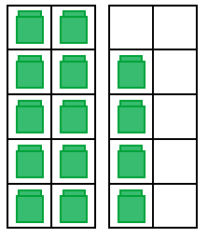
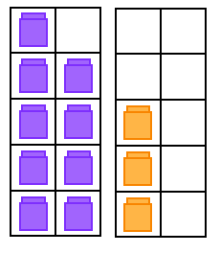
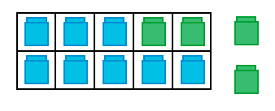

Get Ready!
We’re going to
VISUALIZE our
ADDITION FACTS!

Slide 2
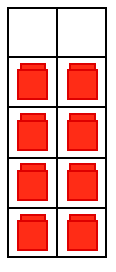
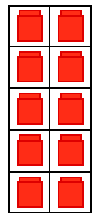
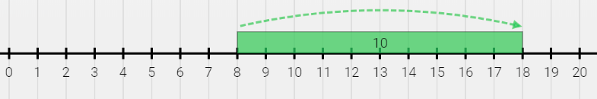
8 + 10 = 18

Slide 3

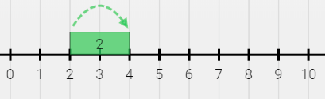

2 + 2 = 4

Slide 4
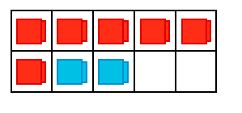

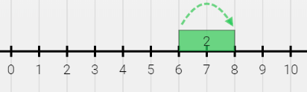
6 + 2 = 8

Slide 5
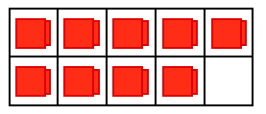
9 + 0 = 9

Slide 6
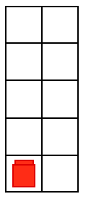
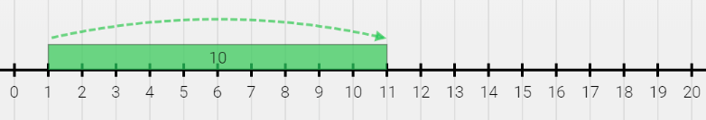
1 + 10 = 11

Slide 7


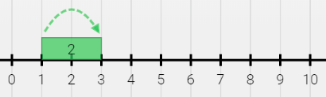
1 + 2 = 3

Slide 8
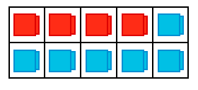
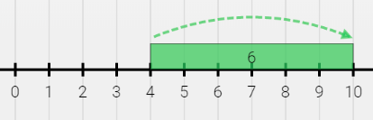

4 + 6 = 10

Slide 9
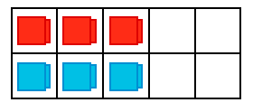

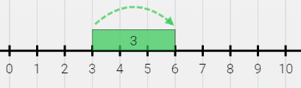
3 + 3 = 6

Slide 10

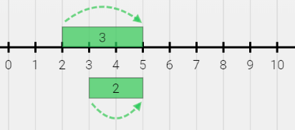

2 + 3 = 5

Slide 11
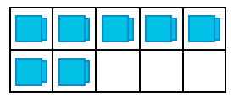
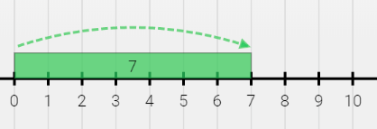
0 + 7 = 7

Slide 12
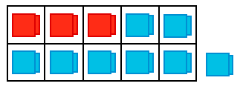
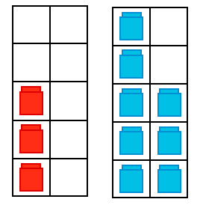

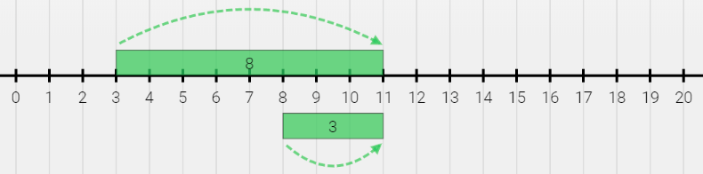
3 + 8 = 11

Slide 13
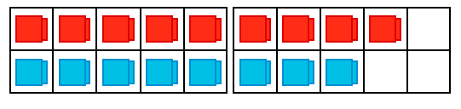
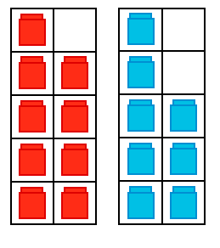
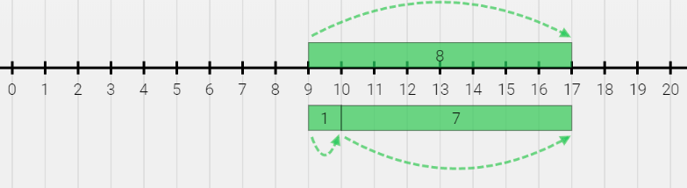
9 + 8 = 17

Slide 14
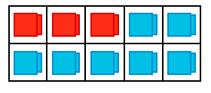
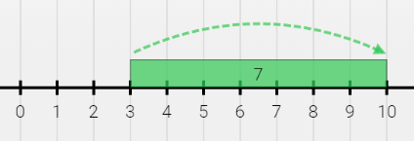

3 + 7 = 10

Slide 15
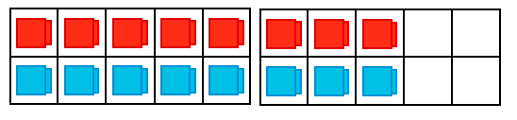
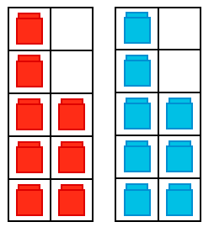

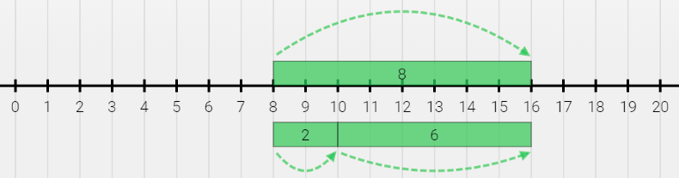
8 + 8 = 16

Slide 16
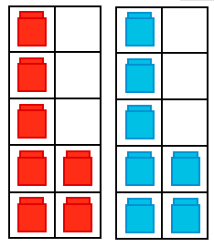
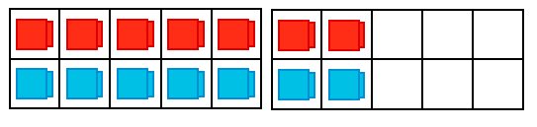

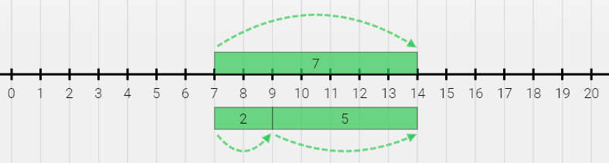
7 + 7 = 14

Slide 17
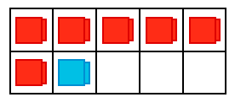
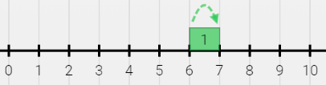

6 + 1 = 7

Slide 18
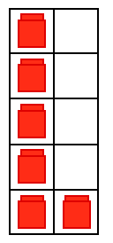
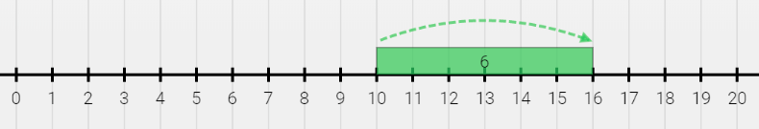
10 + 6 = 16

Slide 19

1 + 0 = 1

Slide 20
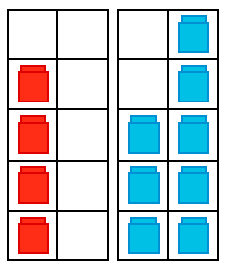
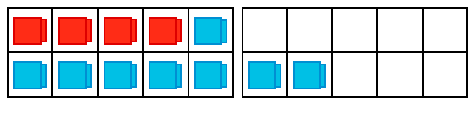

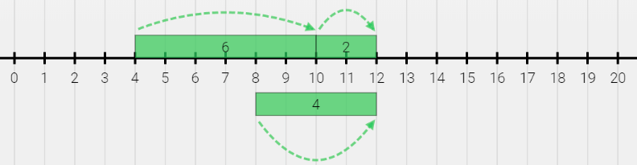
4 + 8 = 12

Slide 21

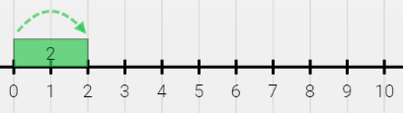
0 + 2 = 2

Slide 22
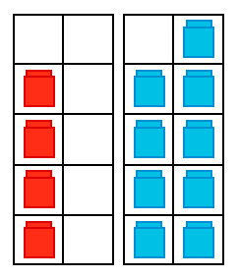
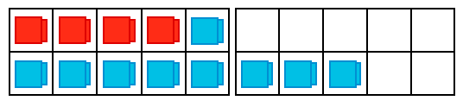

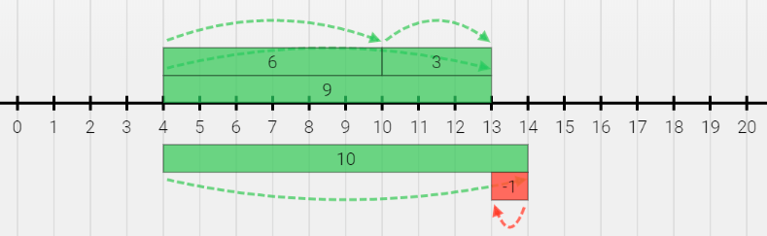
4 + 9 = 13

Slide 23
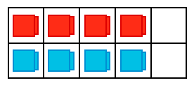
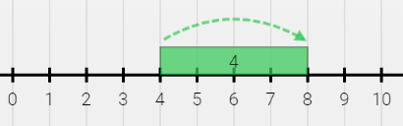

4 + 4 = 8

Slide 24
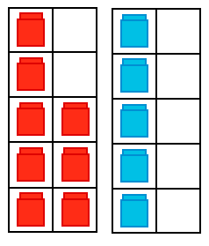
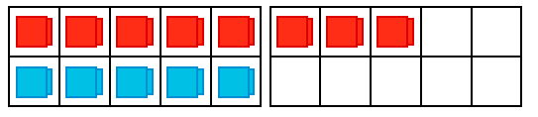

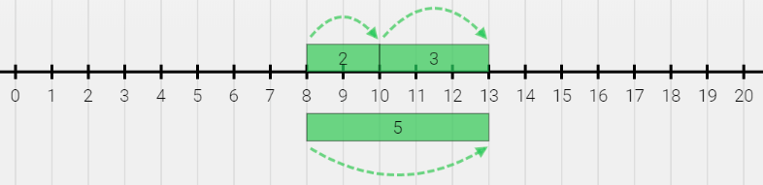
8 + 5 = 13

Slide 25




5 + 9 = 14

Slide 26



2 + 5 = 7

Slide 27



1 + 8 = 9

Slide 28



3 + 6 = 9

Slide 29


0 + 5 = 5

Slide 30




7 + 6 = 13

Slide 31

8 + 0 = 8

Slide 32




8 + 7 = 15
OR

Slide 33



7 + 2 = 9

Slide 34


10 + 4 = 14

Slide 35


0 + 4 = 4

Slide 36




3 + 9 = 12

Slide 37




9 + 9 = 18

Slide 38

6 + 0 = 6

Slide 39



7 + 1 = 8

Slide 40

10 + 10 = 20

Slide 41



4 + 2 = 6

Slide 42



5 + 5 = 10

Slide 43




7 + 9 = 16

Slide 44



5 + 1 = 6

Slide 45



1 + 1 = 2

Slide 46


2 + 10 = 12

Slide 47



1 + 9 = 10

Slide 48


0 + 10 = 10

Slide 49


5 + 10 = 15

Slide 50


3 + 10 = 13

Slide 51




6 + 8 = 14

Slide 52

0 + 0 = 0

Slide 53



3 + 1 = 4

Slide 54




7 + 5 = 12

Slide 55



1 + 4 = 5

Slide 56



5 + 3 = 8

Slide 57



2 + 8 = 10

Slide 58




3 + 4 = 7

Slide 59



4 + 5 = 9

Slide 60


9 + 10 = 19

Slide 61




5 + 6 = 11

Slide 62




6 + 9 = 15

Slide 63


10 + 7 = 17

Slide 64




2 + 9 = 11

Slide 65




6 + 6 = 12

Slide 66

3 + 0 = 3

Slide 67




4 + 7 = 11

Slide 68





Get Ready!
We’re going to
VISUALIZE our
SUBTRACTION FACTS!

Slide 69



5 – 1 = 4

Slide 70



19 – 10 = 9

Slide 71



10 – 2 = 8

Slide 72


11 – 8 = 3
What’s the difference ?

Slide 73
17 – 9 = 8

Slide 74


13 – 7 - 6

Slide 75



4 – 2 = 2
What’s the difference ?

Slide 76

18 – 9 = 9

Slide 77



5 – 3 = 2
What’s the difference ?

Slide 78

15 – 6 = 9

Slide 79



12 – 2 = 10

Slide 80


16 – 8 = 8

Slide 81




7 – 6 = 1
What’s the difference ?

Slide 82



10 – 8 = 2
What’s the difference ?

Slide 83


10 – 10 = 0

Slide 84



6 – 1 = 5

Slide 85



11 – 1 = 10

Slide 86



13 – 3 = 10

Slide 87



9 – 1 = 8

Slide 88


8 – 8 = 0

Slide 89
10 – 0 = 10

Slide 90

16 – 9 = 7

Slide 91




7 – 3 = 4
What’s the difference ?

Slide 92


7 – 4 = 3
What’s the difference ?

Slide 93




6 – 5 = 1
What’s the difference ?

Slide 94

11 – 9 = 2

Slide 95



15 – 5 = 10

Slide 96

8 – 0 = 8

Slide 97


19 – 9 = 10

Slide 98


16 – 7 = 9

Slide 99
5 – 0 = 5

Slide 100


12 – 7 = 5

Slide 101



15 – 10 = 5

Slide 102

14 – 5 = 9

Slide 103



13 – 10 = 3

Slide 104

11 – 3 = 8

Slide 105

3 – 0 = 3

Slide 106



4 – 3 = 1
What’s the difference ?

Slide 107

12 – 4 = 8

Slide 108

11 – 2 = 9

Slide 109

12 – 8 = 4

Slide 110

13 – 5 = 8

Slide 111




6 – 4 = 2
What’s the difference ?

Slide 112
4 – 0 = 4

Slide 113



16 – 6 - 10

Slide 114

14 – 9 = 5

Slide 115


9 – 9 = 0

Slide 116



18 – 10 - 8

Slide 117

13 – 9 = 4

Slide 118

3 – 3 = 0

Slide 119

4 – 4 = 0

Slide 120



8 – 1 = 7

Slide 121




9 – 4 = 5

Slide 122

0 – 0 = 0

Slide 123



9 – 8 = 1
What’s the difference ?

Slide 124


14 – 8 = 6

Slide 125
9 – 0 = 9

Slide 126


10 – 6 = 4

Slide 127




2 – 1 = 1
What’s the difference ?

Slide 128



17 – 10 = 7

Slide 129




8 – 6 = 2
What’s the difference ?

Slide 130




6 – 3 = 3

Slide 131

8 – 2 = 6

Slide 132



8 – 3 = 5

Slide 133



9 – 6 = 3
What’s the difference ?

Slide 134


14 – 7 = 7

Slide 135


4 – 1 = 3

Slide 136



9 – 5 = 4

Slide 137



6 – 2 = 4

Slide 138


1 – 1 = 0

Slide 139


10 – 9 = 1
What’s the difference ?

Slide 140


10 – 7 = 3

Slide 141

5 – 5 = 0

Slide 142


10 – 4 = 6

Slide 143



12 – 10 = 2

Slide 144


15 – 7 = 8

Slide 145


13 – 6 = 7

Slide 146

6 – 0 = 6

Slide 147



7 – 1 = 6

Slide 148
1 – 0 = 1

Slide 149

11 – 7 = 4

Slide 150



9 – 7 = 2
What’s the difference ?

Slide 151

2 – 2 = 0

Slide 152


11 – 6 = 5

Slide 153


12 – 6 = 6

Slide 154

12 – 3 = 9

Slide 155


13 – 8 = 5

Slide 156



5 – 4 = 1
What’s the difference ?

Slide 157



7 – 2 = 5

Slide 158


9 – 3 = 6

Slide 159


18 – 8 = 10

Slide 160


17 – 8 = 9

Slide 161



14 – 10 = 4

Slide 162


15 – 8 = 7

Slide 163


10 – 1 = 9

Slide 164

7 – 0 = 7

Slide 165


12 – 5 = 7

Slide 166


5 – 2 = 3

Slide 167
2 – 0 = 2

Slide 168

13 – 4 = 9

Slide 169

12 – 9 = 3

Slide 170


3 – 1 = 2

Slide 171

10 – 3 = 7

Slide 172


8 – 5 = 3

Slide 173



8 – 4 = 4

Slide 174




7 – 5 = 2
What’s the difference ?

Slide 175


10 – 5 = 5

Slide 176


17 – 7 = 10

Slide 177



14 – 6 = 8

Slide 178



3 – 2 = 1
What’s the difference ?

Slide 179



20 – 10 = 10

Slide 180



16 – 10 = 6

Slide 181

11 – 4 = 7

Slide 182



14 – 4 = 10

Slide 183

15 – 9 = 6

Slide 184


7 – 7 = 0

Slide 185


11 – 5 = 6

Slide 186



11 – 10 = 1

Slide 187



8 – 7 = 1
What’s the difference ?

Slide 188


9 – 2 = 7

Slide 189


6 – 6 = 0

