Slide 1
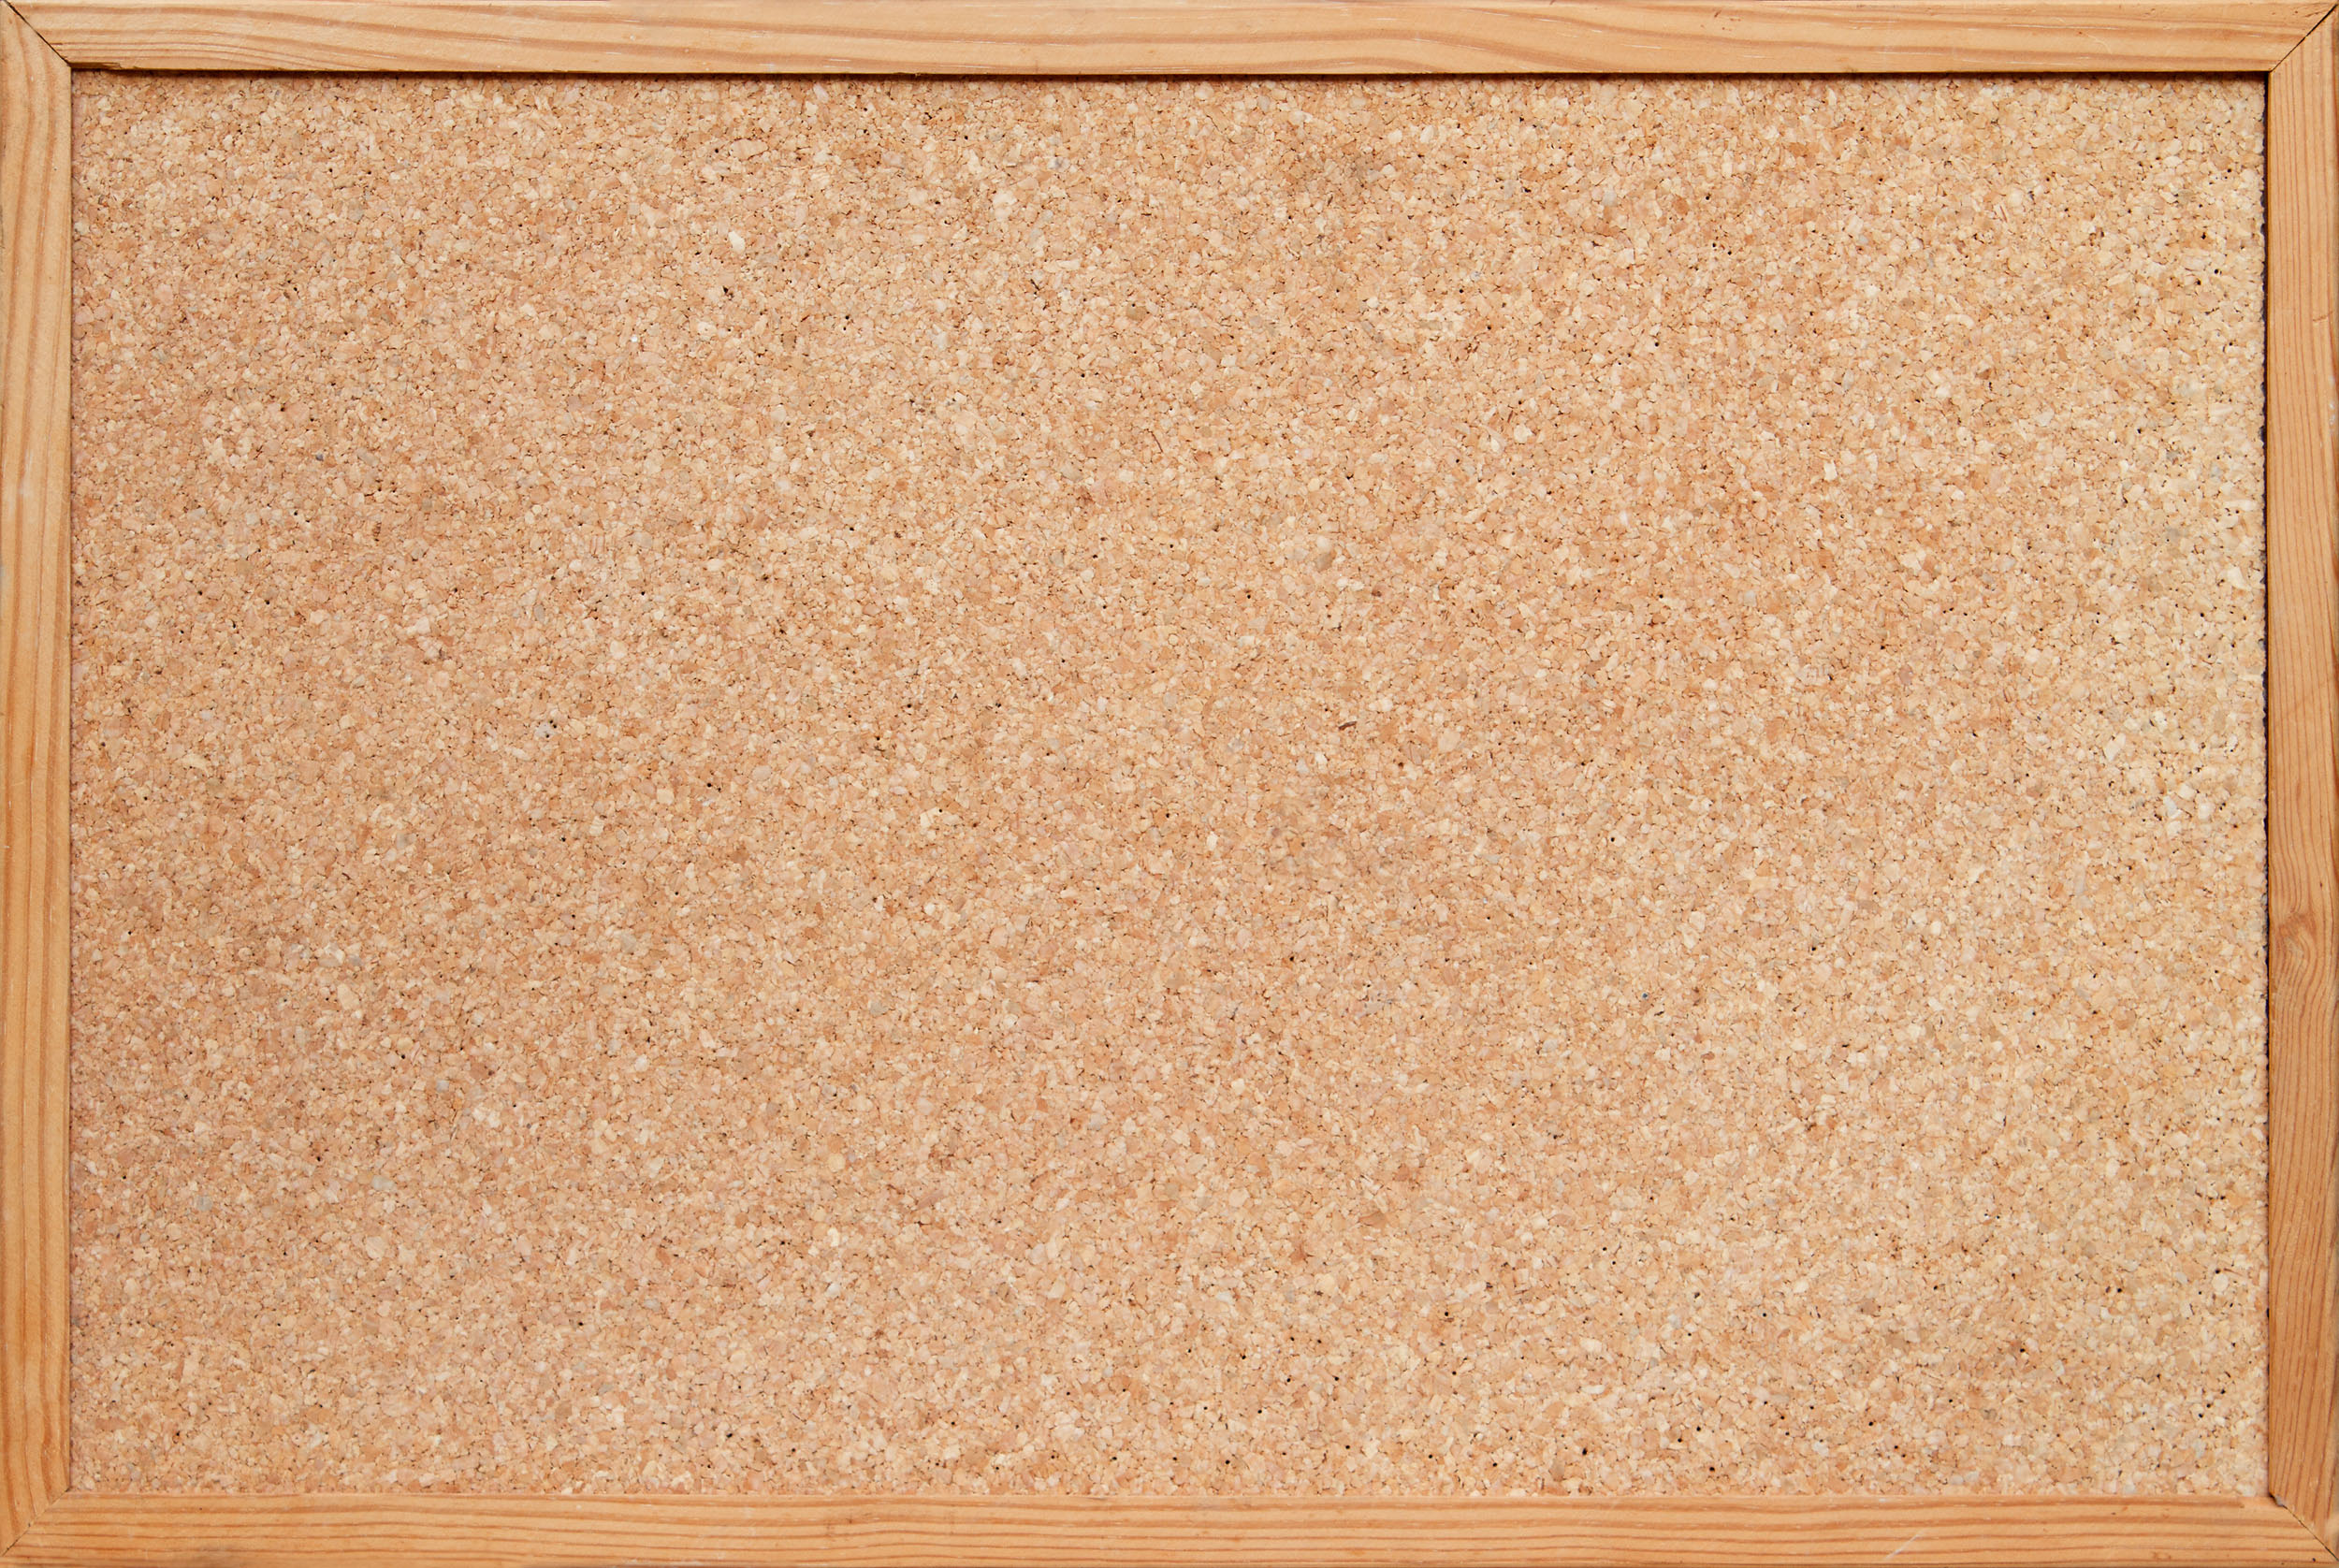
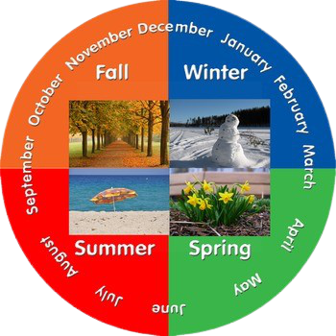
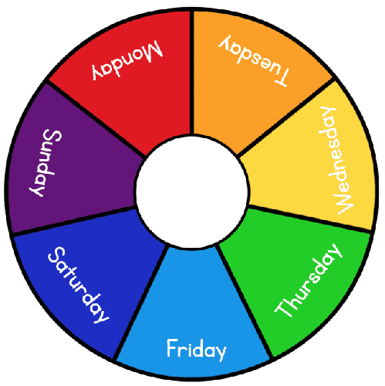
today

Slide 2
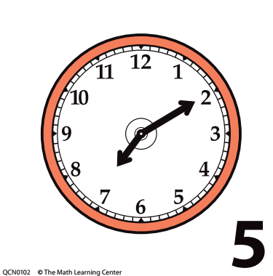
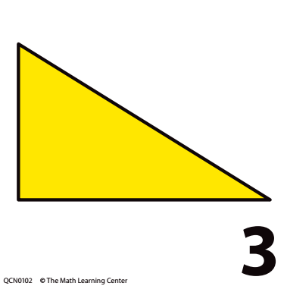
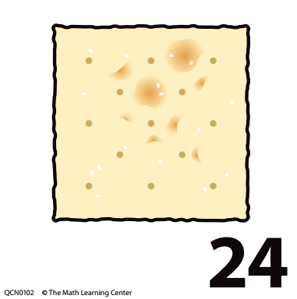
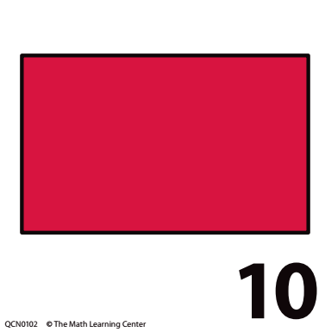
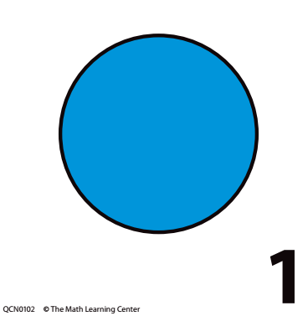
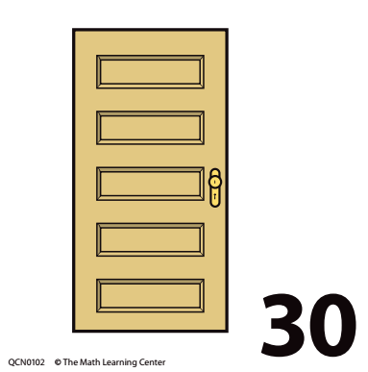
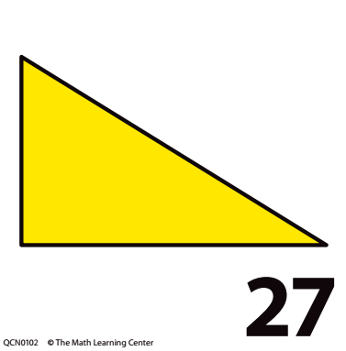
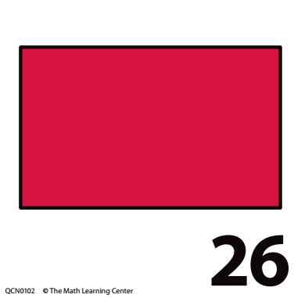
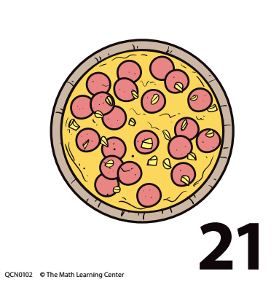
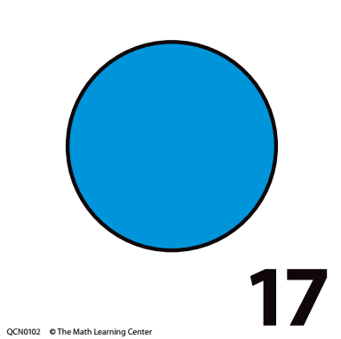
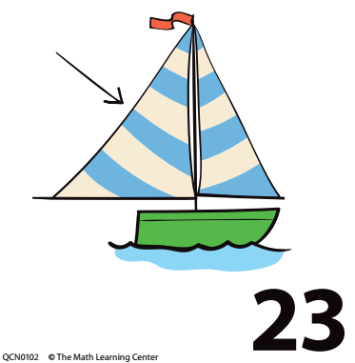
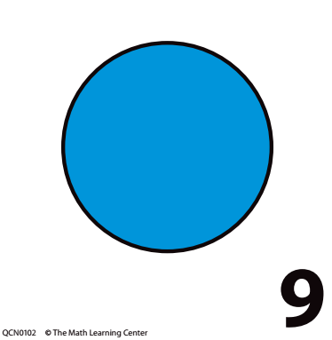
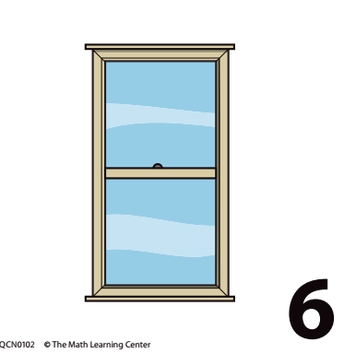
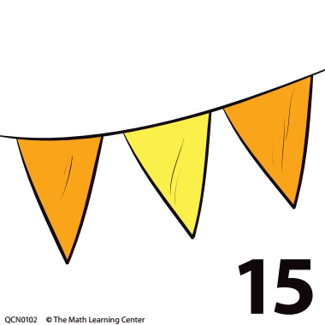
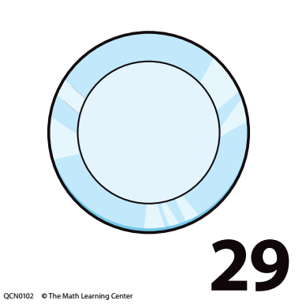
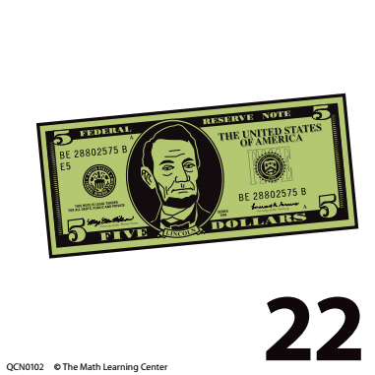
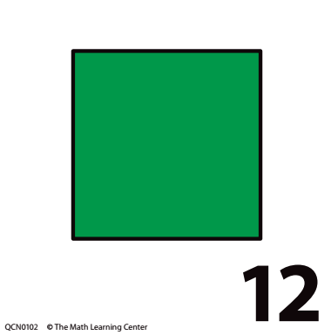
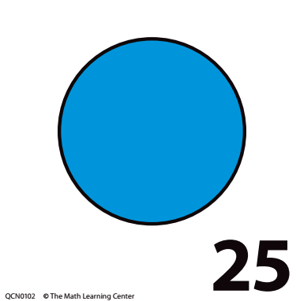
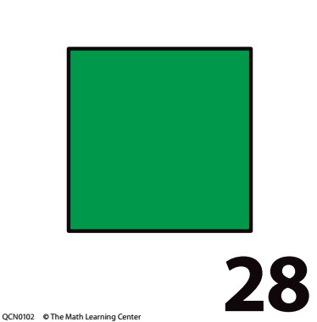
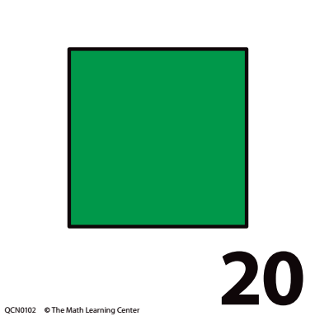
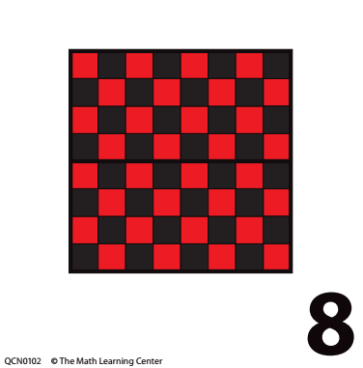
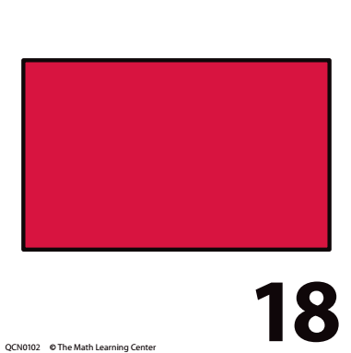
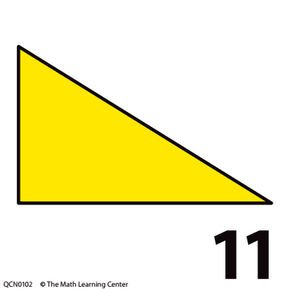
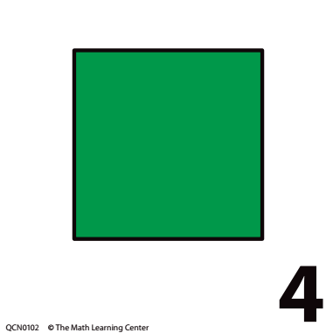
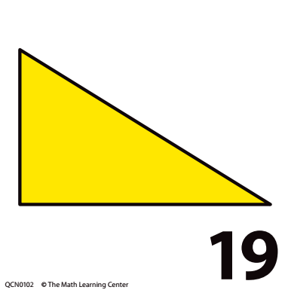
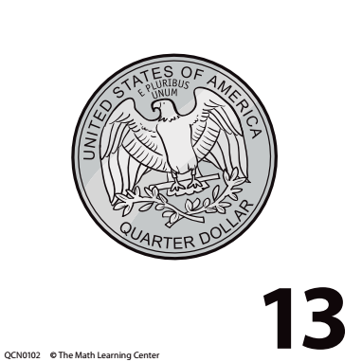
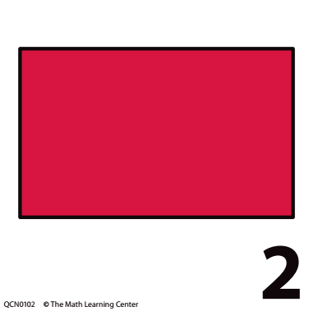
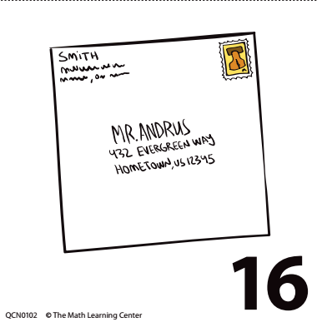
September 2021
Pull calendar pieces

Slide 3
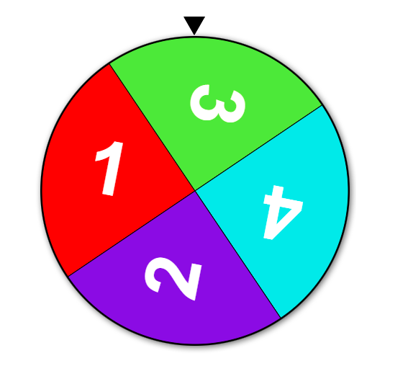
Right Click me to go to spinner!

Slide 4
1 2 3 4 5 6 7 8 9 10 11 12 13 14 15 16 17 18 19 20
Notes:
Key Questions
• How many dots did we have on the ten-frame yesterday? Can you show with your fingers? How did you count the dots?
• How many dots will we have on the ten-frame after we add the dot for today? How do you know?
• How many more dots do we need to add to the ten-frame to complete the first row of 5? How many more to fill every box on the frame to 10? How do you know?
• How many links did we have in our chain yesterday? Can you show with your fingers? Let’s count to check.
• How many links will we have in the chain after we add 1 for today? How do you know?
• How many more links do we need to add to our chain to make a group of 5? How many more to make a group of 10? How do you know?
• What number do we need to write on our class number line today?

Slide 5
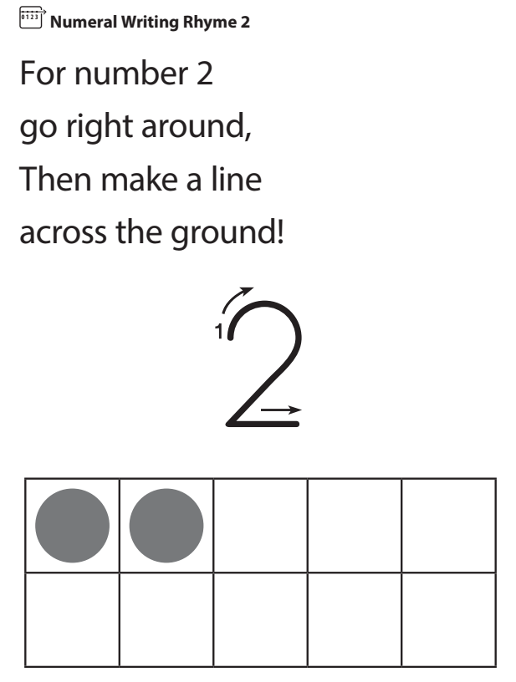
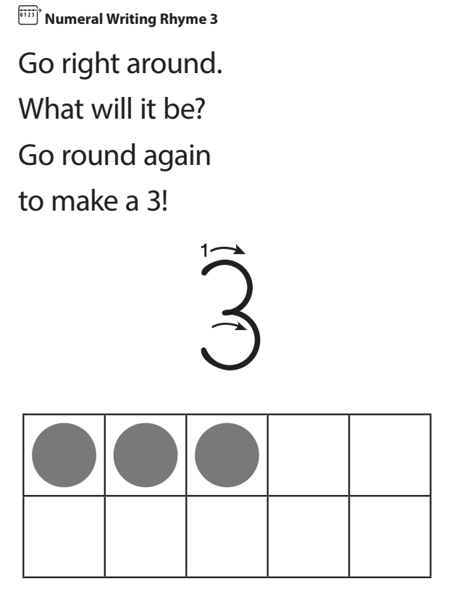
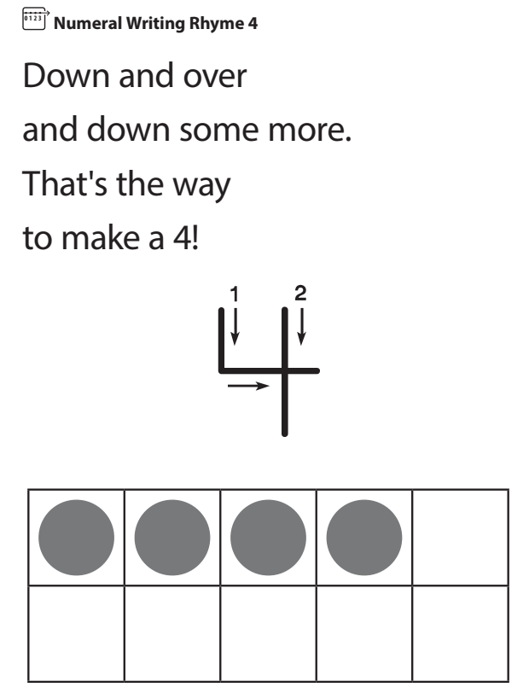
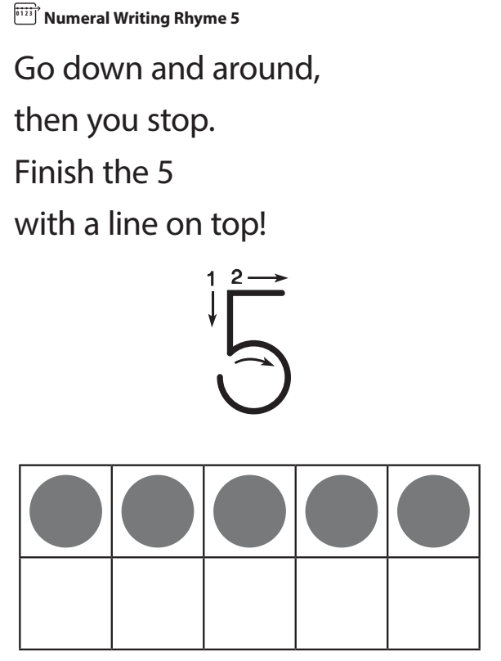
September Pattern Strip
Notes:
Key Questions
• Show several numeral cards and ask, “Can you find the 6?” or any revealed number.
• Point to a numeral card and ask students what is this number’s name?
• If this number is 4 (2, 5, 8) what will this number be (point to the next number in the sequence)?
• How does saying the counting sequence help you find a number in the Number Line pocket chart?
These questions will be more challenging:
• What number comes after (any given number 0–9)? How do you know?
• What number comes before (any given number 1–10)? How do you know?
• What number(s) comes between (two given numbers)? Can you prove it?

Slide 11
Circles we see in the world

Slide 12
Rectangles we see in the world

Slide 13
Triangles we see in the world

Slide 14
Squares we see in the world

